Slide 1
My Hotel
Welcome to Paradise Island

Slide 2
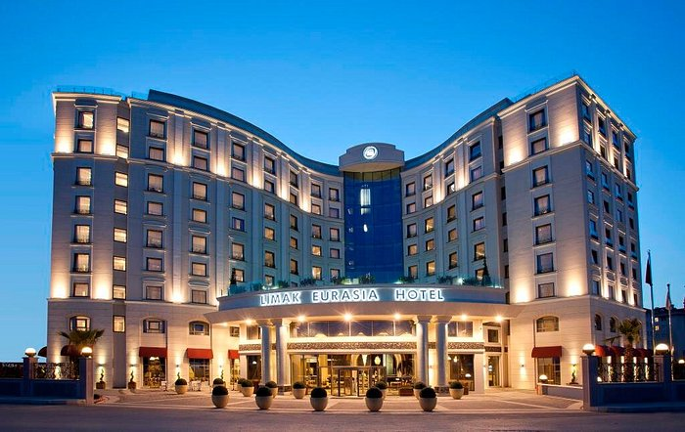
My micro service is a hotel
I am the owner of the hotel and will show you the steps to book a room in my luxurious establishment

Slide 3
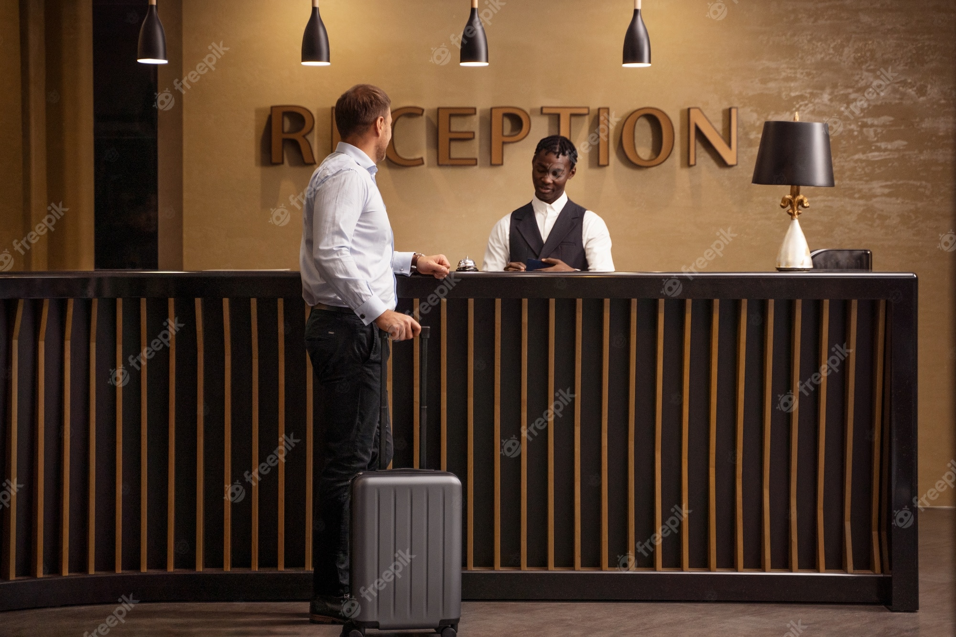
You will need to follow the procedure when booking in
Filing in personal info form
Picking an Available room
Tell the receptionist about your stay
Put in your bank Details
Paying the Amount

Slide 4
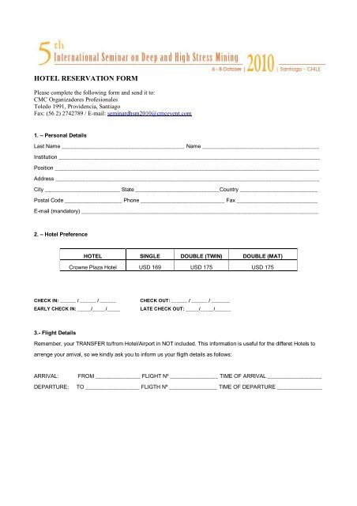
Filling in your Personal Information
You will need to enter your
Title
Name
Number
Phone
ID
AGE
There are certain conditions that need to be met while filing this in.

Slide 5
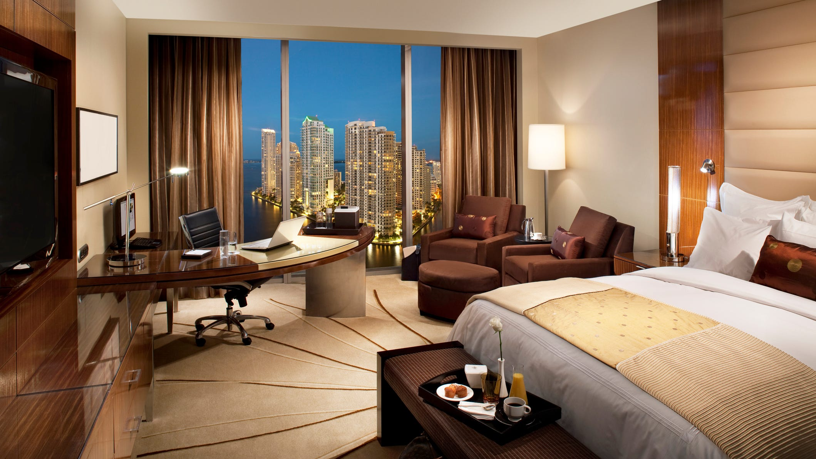
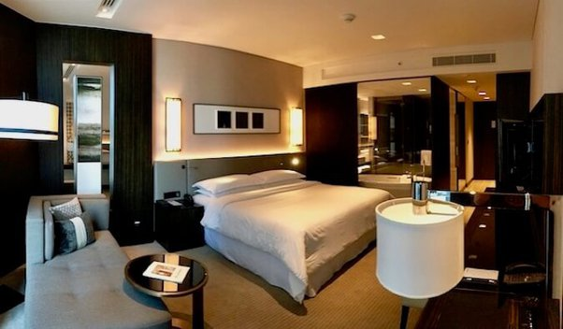
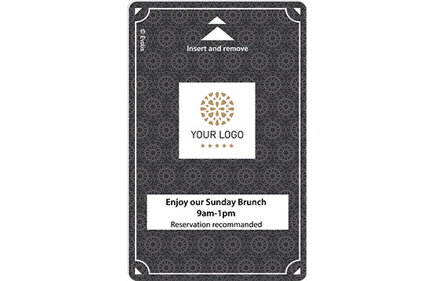
Booking a Room
We will check our database and we will tell you the available rooms
You will then be given the option to pick one of the available rooms

Slide 6
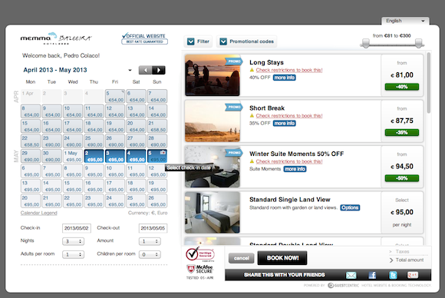
Info about your stay
You will need to enter your length of stay
Confirm you are okay with the standard rate
Confirm that you are okay with the tax rate
Let us know if you have a discount code

Slide 7
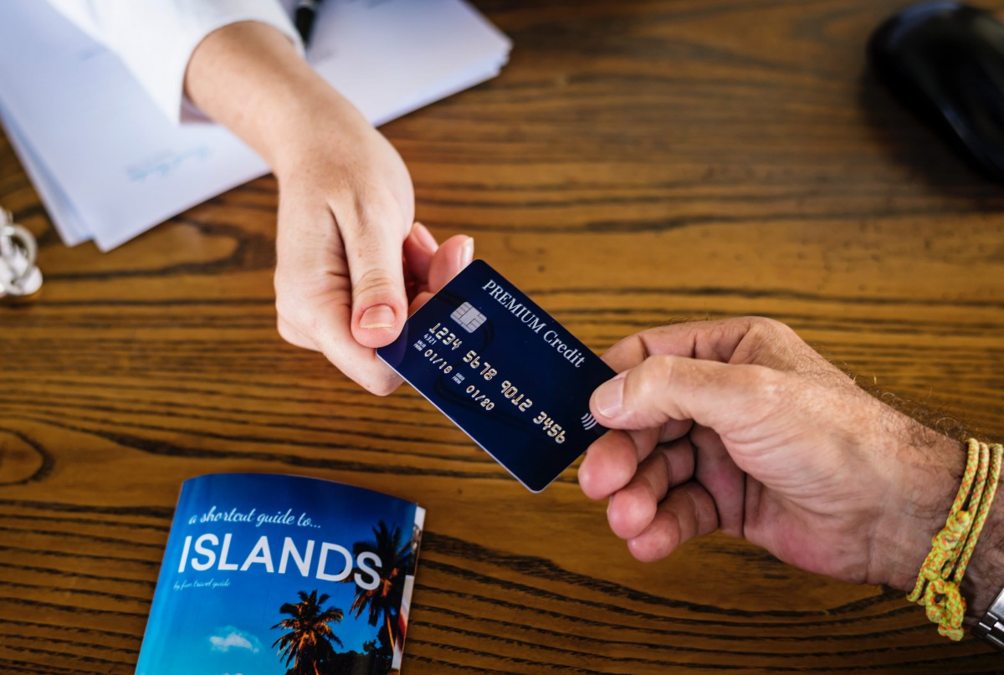
Bank details
You need to enter your bank details
Bank Number
Name
CVV
Expired Number

Slide 8
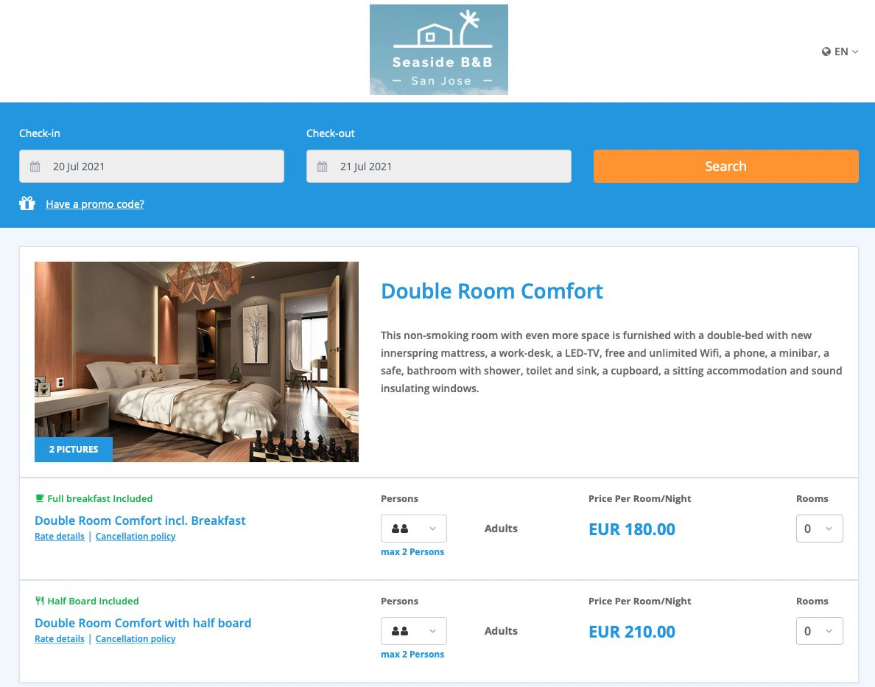
Paying for your stay
You will need to enter your length of stay
The standard rate of a room is 100 euro
There is a 5% tax up for every night that you stay here
You can also enter a discount code to get 20% off.

Slide 9

Thank You for choosing my hotel
And
Hope you have an amazing stay

